Slide 1
COMPUTER SYSTEM: A TOUR
STUDENT:葉梅 ID NUMBER:4110E241 TEAHER:TO MY DEAR GREAT TEACHER

Slide 2
AGENDA
COMPUTER SOFTWARE: OPERATING SYSTEMCOMPUTER SYSTEM
COMPUTER HARDWARE
COMPUTER SOFTWARE:OPERATING SYSTEM
Computer System UAV == unmanned aerial vehicle == 無人機
Computer System GOOGLE CLOUD
Computer hardware iphone
C

Slide 3
AGENDA
Computer hardware von neuman architecture
Memory hierarchy
PRINCIPLE OF LOCALITY
RAM VS ROM
Dram vs sram
COMPUTER SOFTWARE: OPERATING SYSTEMCOMPUTER SYSTEM
KINDS OF OS
TCP IP PROTOCOL

Slide 4
Computer system

Slide 5
1.
WHAT IS COMPUTER SYSTEM?

Slide 6
COMPUTER SYSTEM
A computer system is a basic, complete and functional hardware and software setup with everything needed to implement computing performance.
A computer system is a basic, complete and functional hardware and software setup with everything needed to implement computing performance.

Slide 7
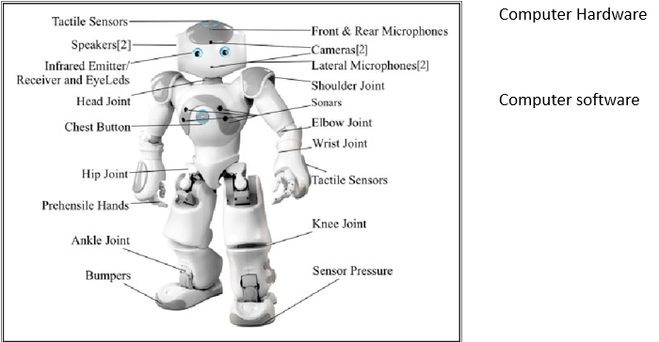
Computer system

Slide 8
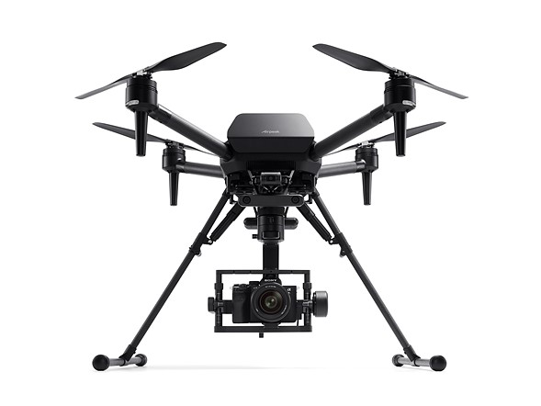
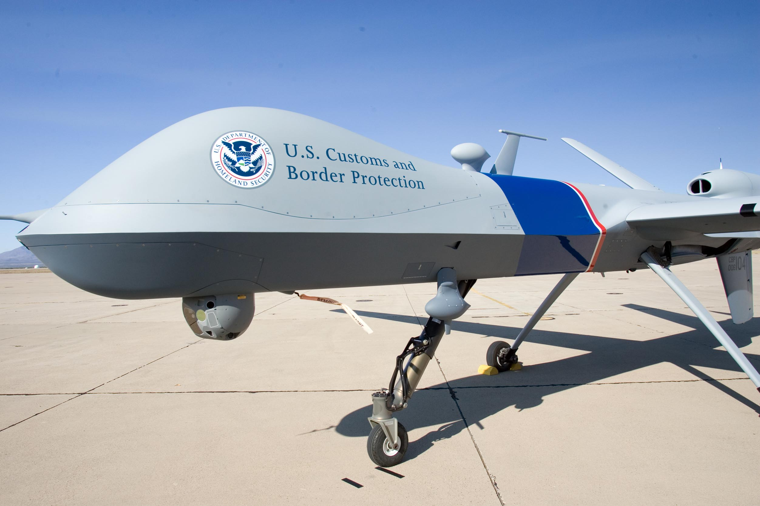
Computer System UAV == unmanned aerial vehicle == 無人機
Computer System UAV == unmanned aerial vehicle == 無人機

Slide 9

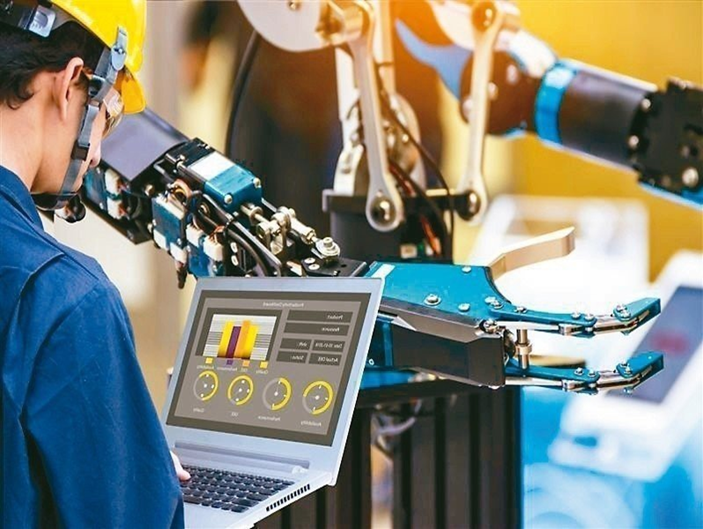
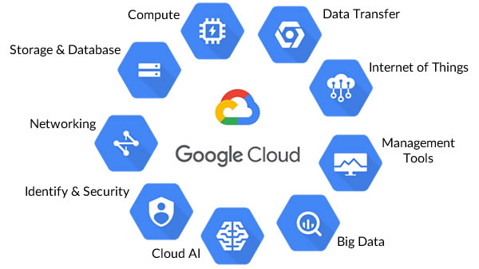
Computer system google cloud

Slide 10
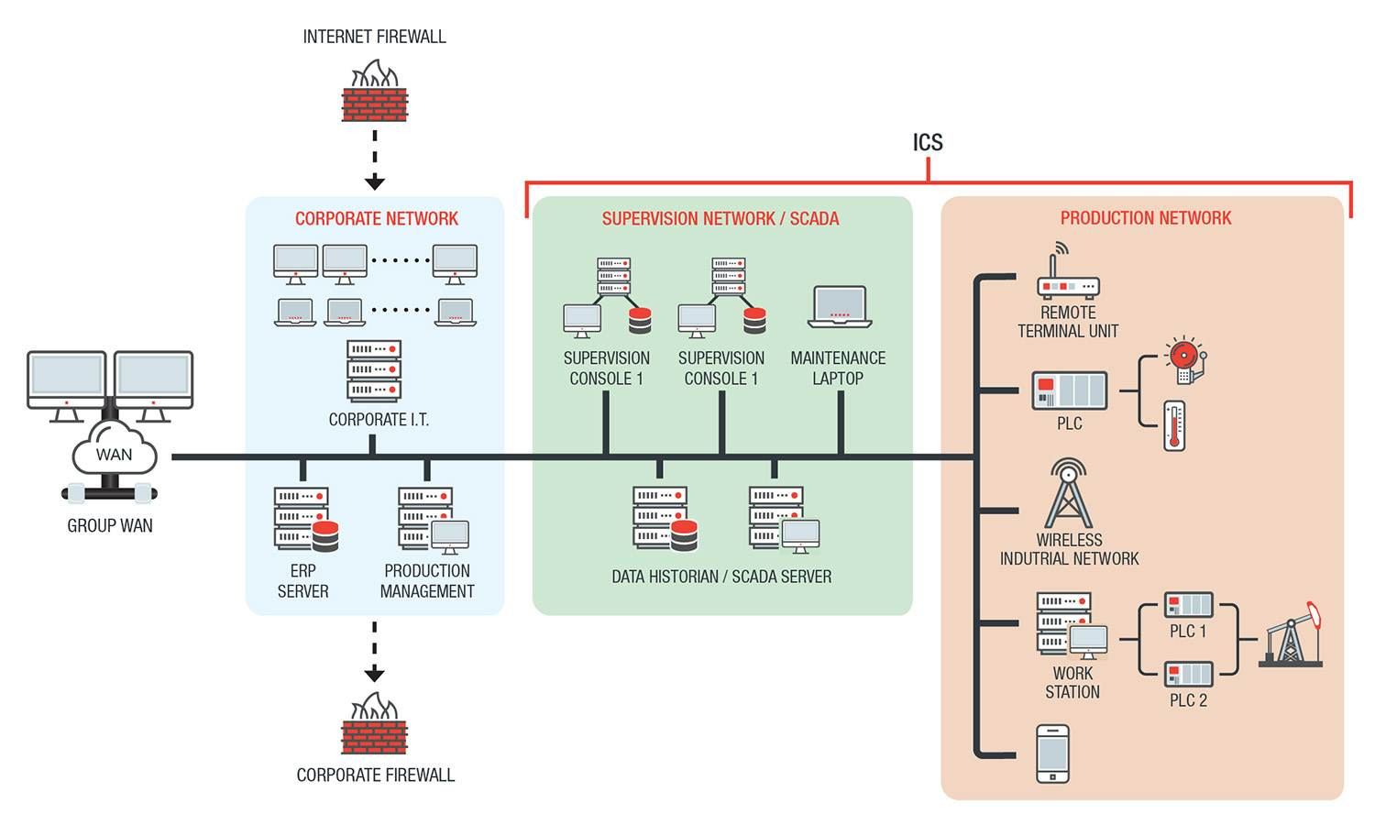
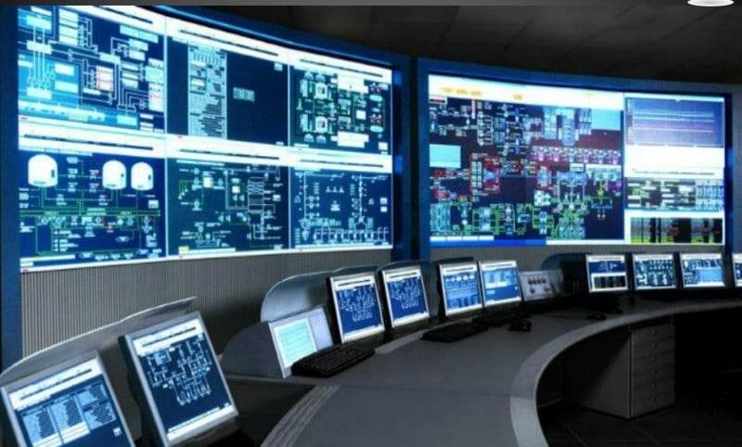
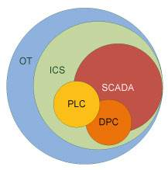

Computer system I(Industrial Control System,ICS) https://blog.trendmicro.com.tw/?p=67721

Slide 11
Computer network

Slide 12
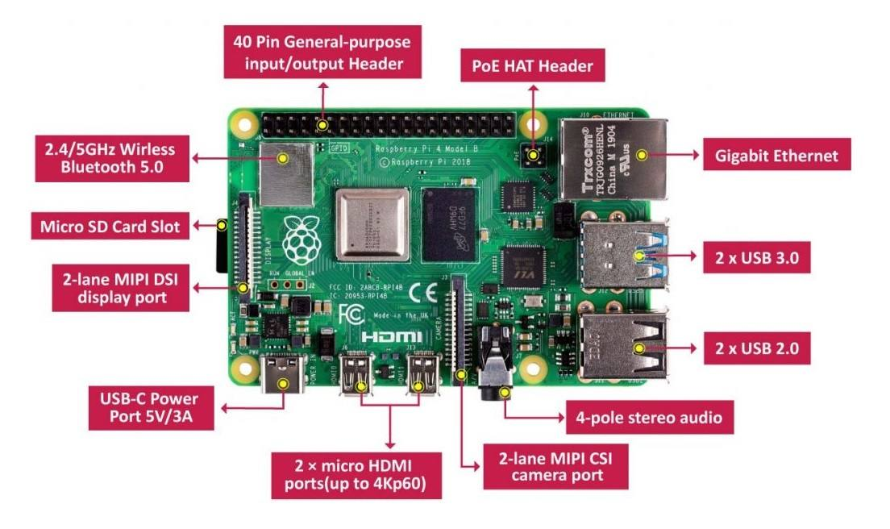
computer hardware Raspberry Pi 4
Raspberry pi runs a Debian-based operating system known as Raspbian (Raspberry Pi OS). It is officially provided by the Raspberry Pi foundation.
It has a 64bit quad-core processor having cortex-A72 (ARM v8) clocked @1.5GHz.
The new Pi board includes Broadcom BCM2711 VC6 GPU able to handle two 4kp30 displays also it can handle H.265 decoding at 4kp60. It has two micro HDMI ports.
Now the new Pi board comes in 2GB, 4GB, and 8GB LPDDR-4 RAM options.
It has a dual-band 2.4/5.0 GHz Wi-Fi, Bluetooth 5.0, Gigabit Ethernet Port, 2 USB 3.0, and 2 USB 2.0 ports.
USB type C power input port. Also, it has POE capability via separate POE HAT (add-on).
It has a standard 40 pin GPIO header (having backward compatibility)

Slide 13
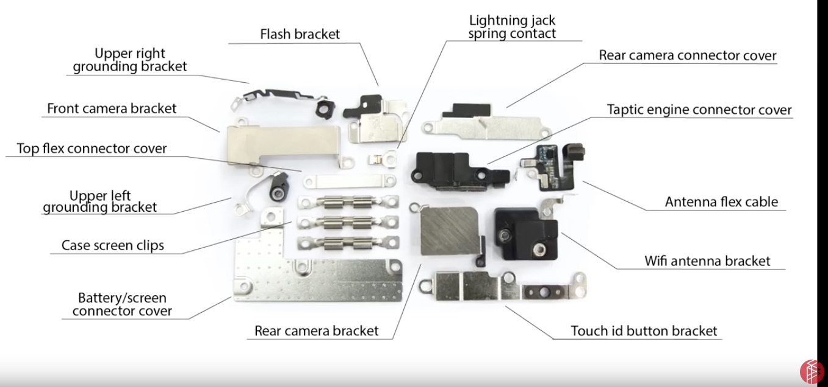
Computer hardware iphone

Slide 14

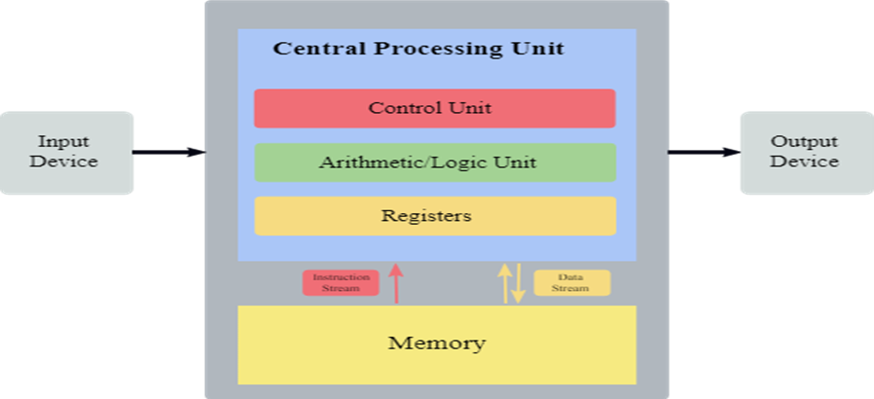
Computer hardware von neuman architecture
also known as the von Neumann model or Princeton architecture — is a computer architecture based on a 1945 description by John von Neumann, and by others, in the First Draft of a Report on the EDVAC.^{[1}
A processing unit with both an arithmetic logic unit and processor registers
A control unit that includes an instruction register and a program counter
Memory that stores data and instructions
External mass storage
Input and output mechanisms^{[1][}

Slide 15
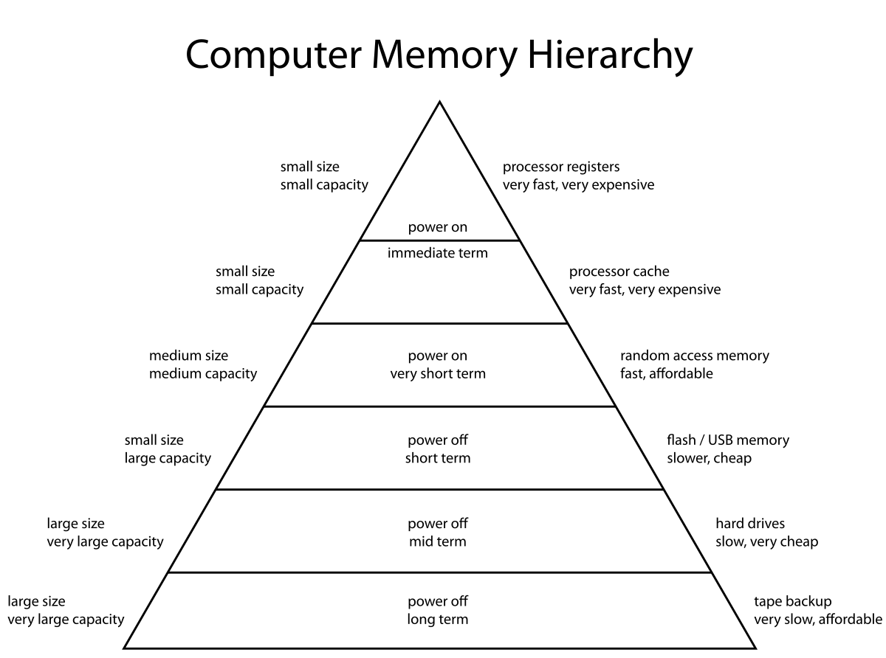
Memory hierarchy https://en.wikipedia.org/wiki/Memory.hierarchy
he memory hierarchy separates computer storage into a hierarchy based on response time.
Since response time, complexity, and capacity are related, the levels may also be distinguished by their performance and controlling technologies.
Memory hierarchy affects performance in computer architectural design, algorithm predictions, and lower level programming constructs involving locality of reference.

Slide 16
PRINCIPLE OF LOCALITY
In computer science, locality of reference, also known as the principle of locality, is the tendency of a processor to access the same set of memory locations repetitively over a short period of time. There are two basic types of reference locality – temporal and spatial locality.

Slide 17
RAM VS ROM
RAM, which stands for random access memory, and ROM, which stands for read-only memory, are both present in your computer. RAM is volatile memory that temporarily stores the files you are working on. ROM is non-volatile memory that permanently stores instructions for your computer.

Slide 18
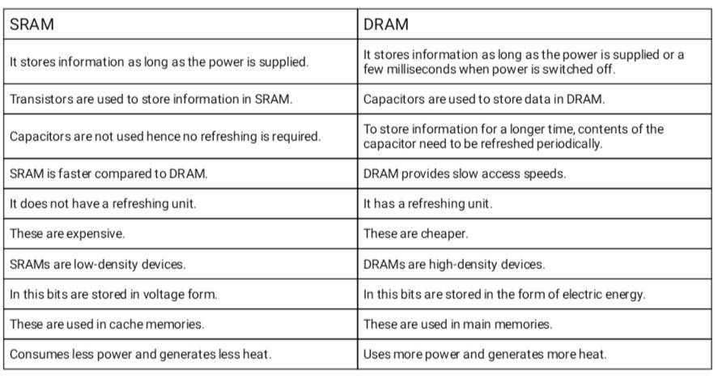
Dram vs sram

Slide 19
COMPUTER SOFTWARE:
OPERATING SYSTEM

Slide 20
COMPUTER SOFTWARE: OPERATING SYSTEM
What is operation system(OS)
kind of OS:
Service/Function provided by OS
Windows operating system
linux operating system

Slide 21
WHAT IS OPERATION SYSTEM(OS)

Slide 22
KIND OF OS
Server:Linux, windows server 2022
Desktop OS: Windows 10/11
Mobile OS: android, ios
Real-time OS: RTOS Real-Time Operating System (RTOS)

Slide 23
SERVICE/FUNCTION PROVIDED BY OS

Slide 24
WINDOWS OPERATING SYSTEM

Slide 25
TCP IP
PROTOCOL

Slide 26
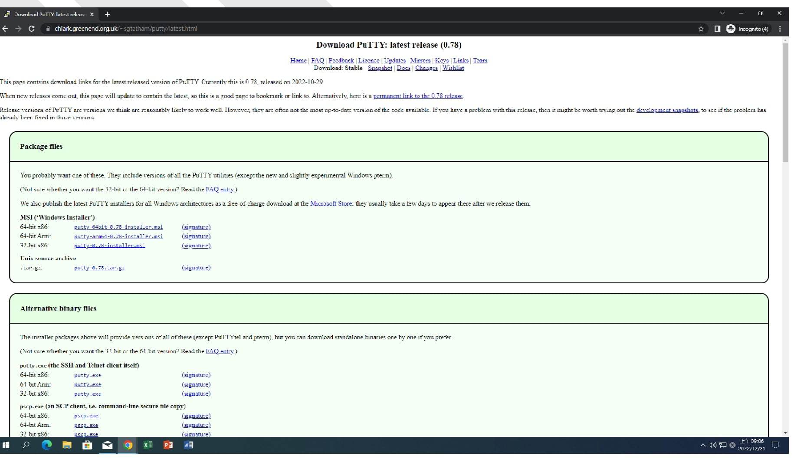
LINUX

Slide 27
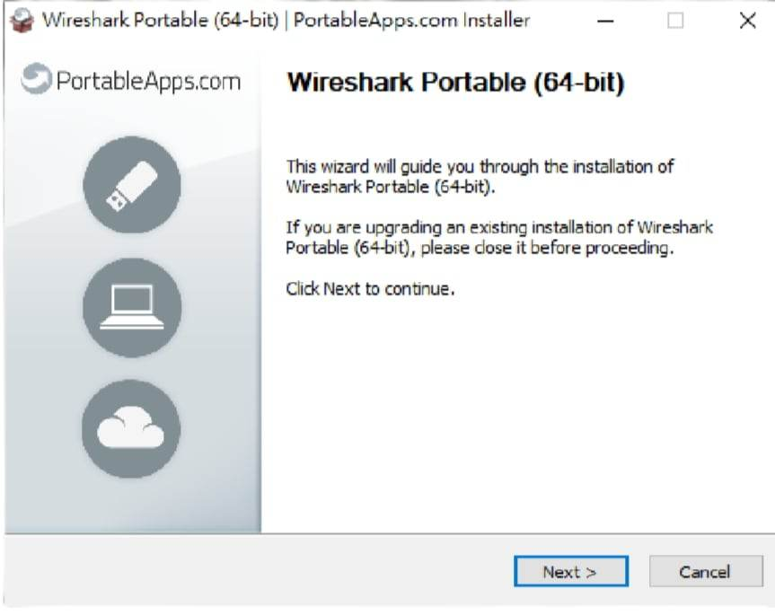
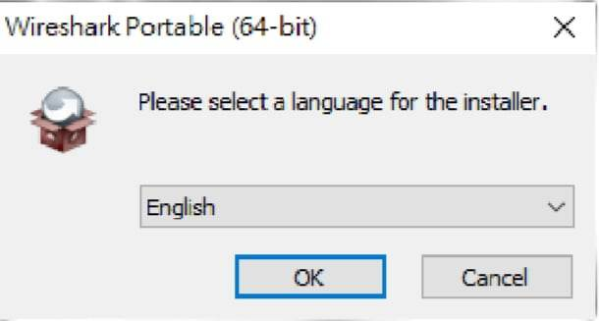

Slide 28
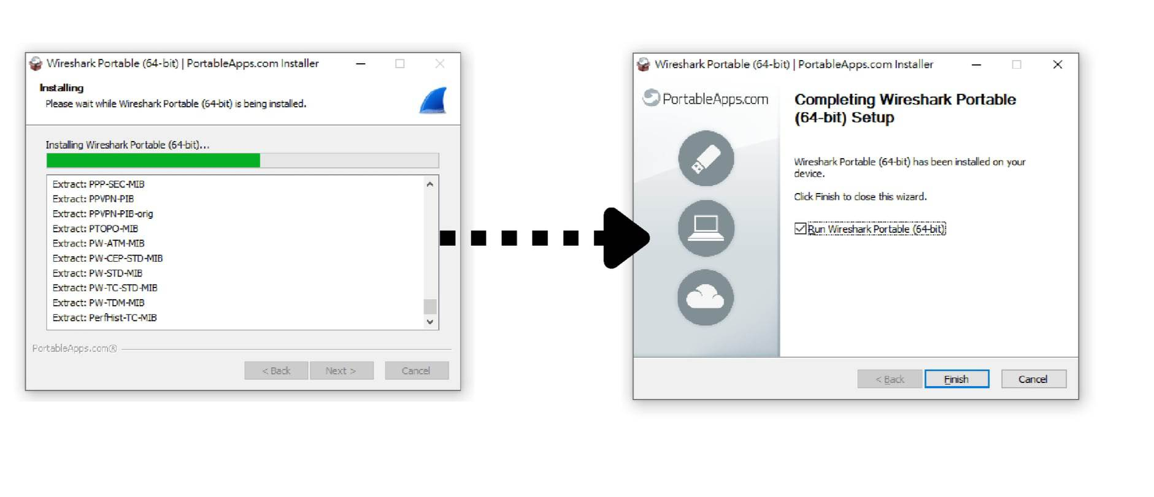

Slide 29
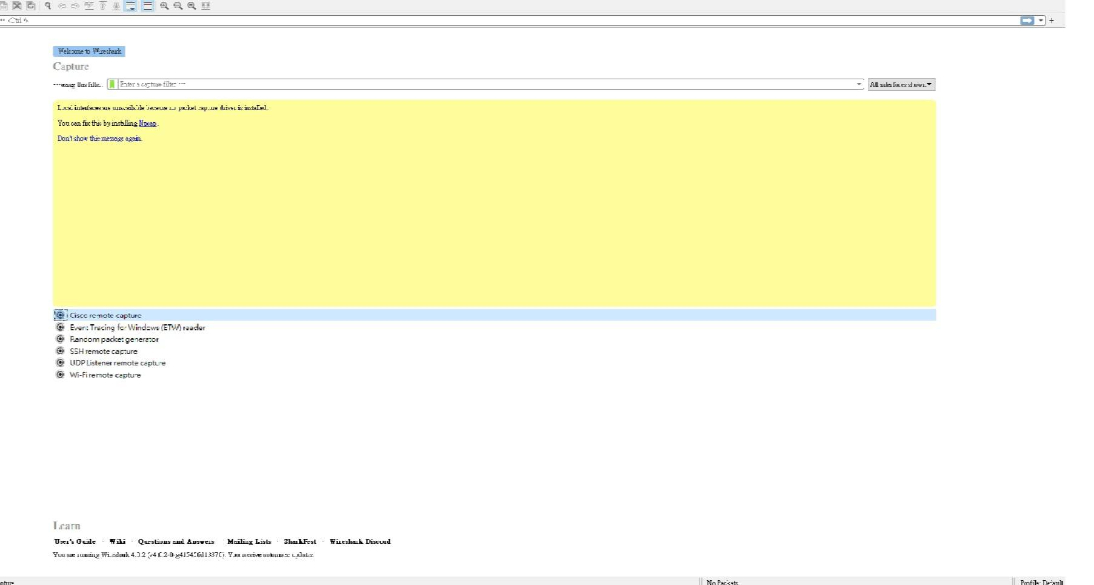

Slide 30
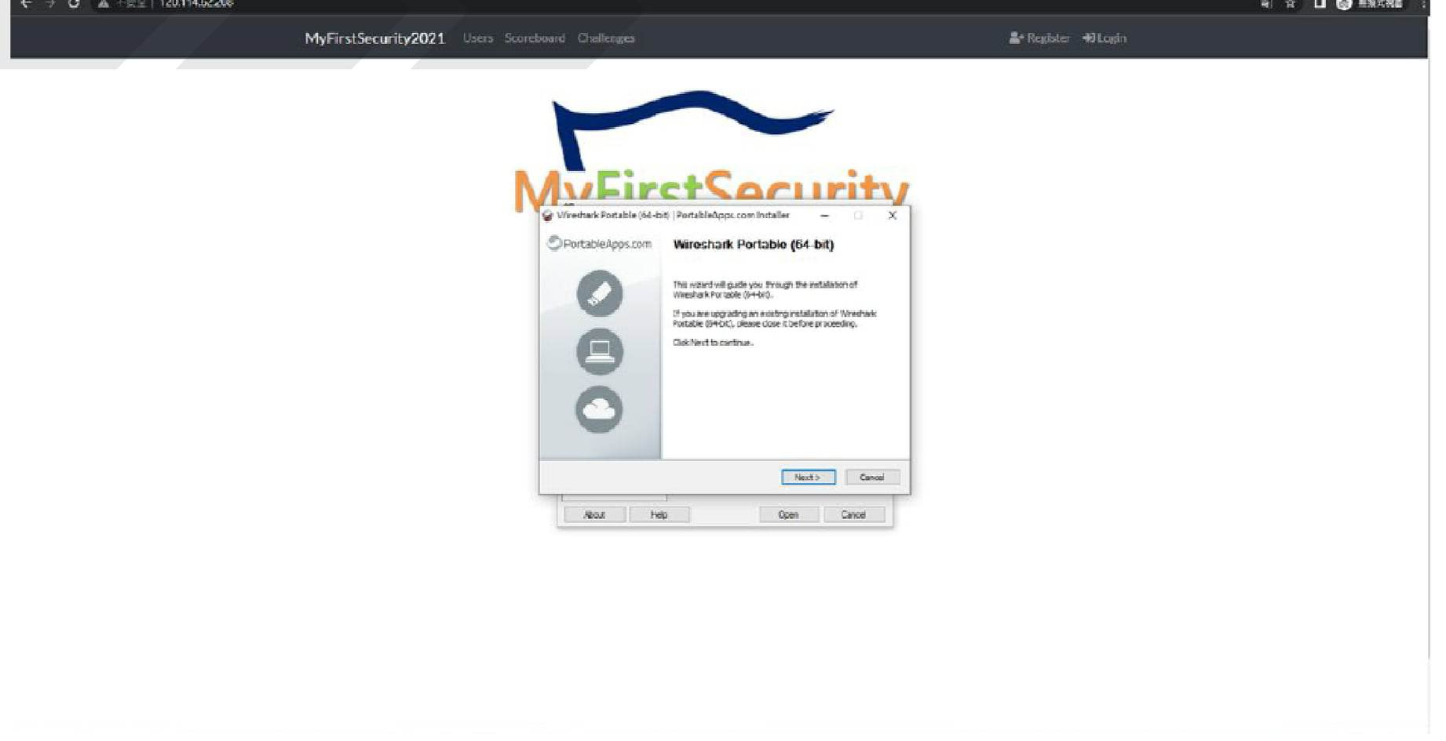

Slide 31
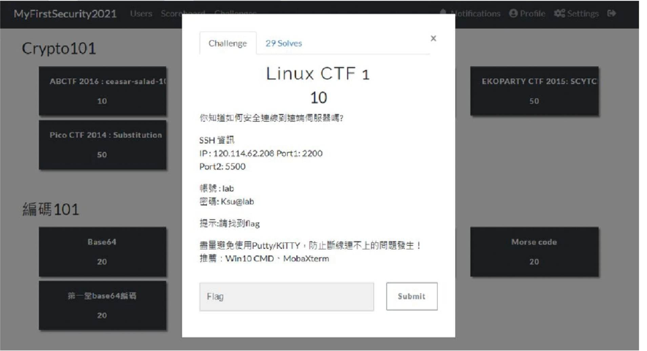

Slide 32
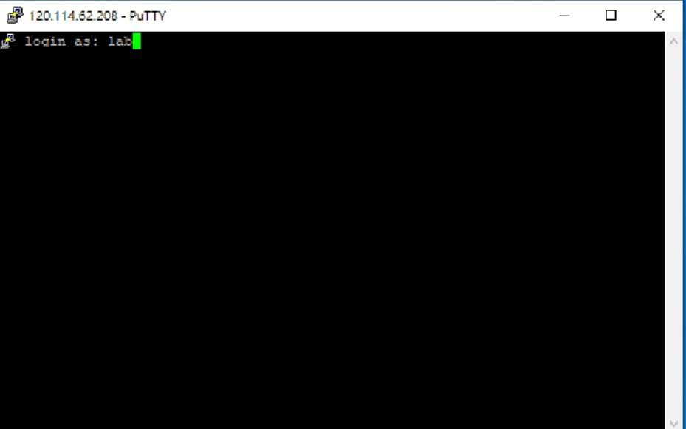
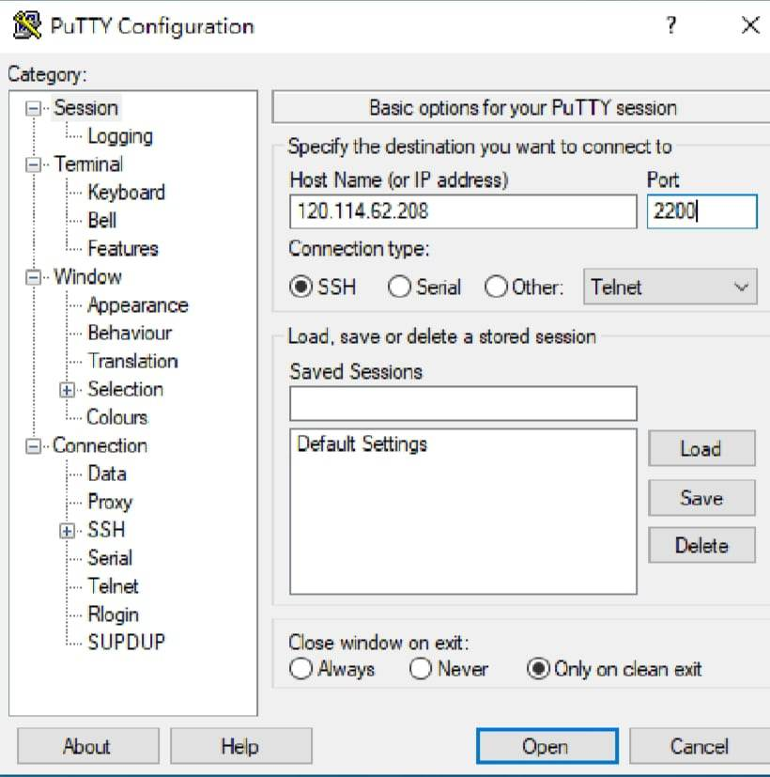

Slide 33
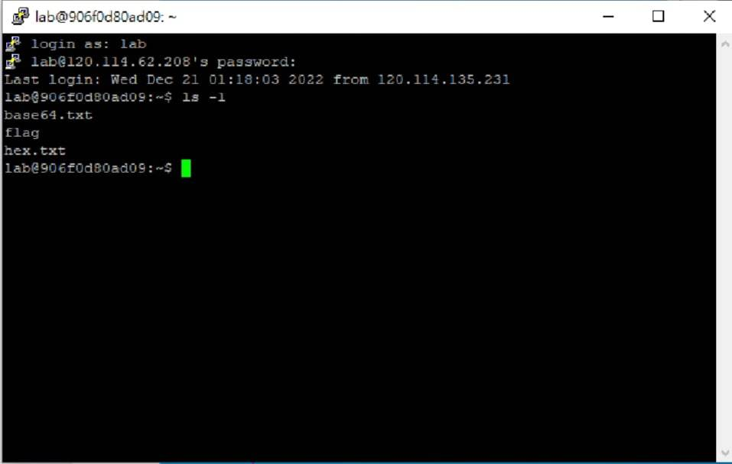
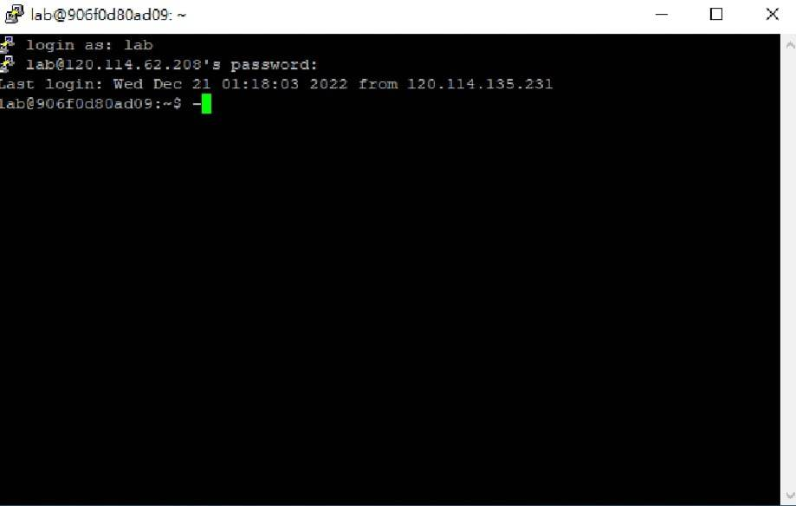

Slide 34
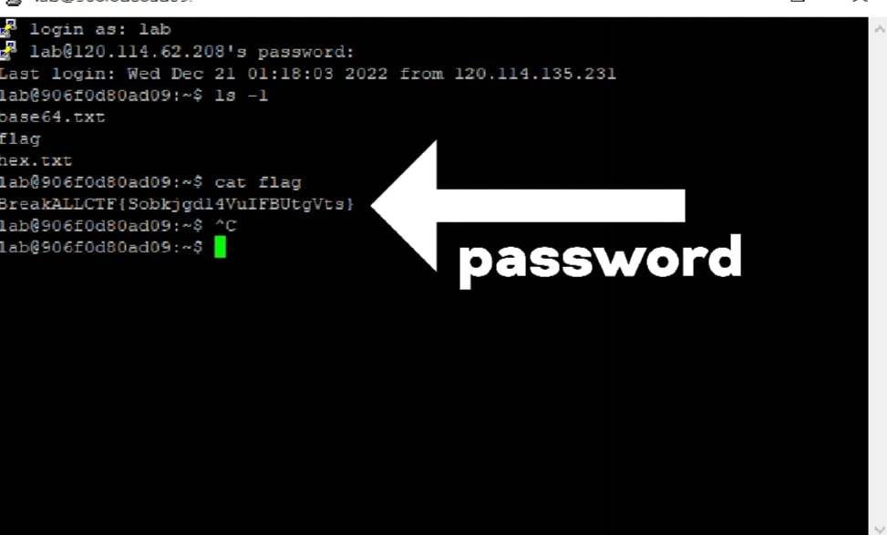
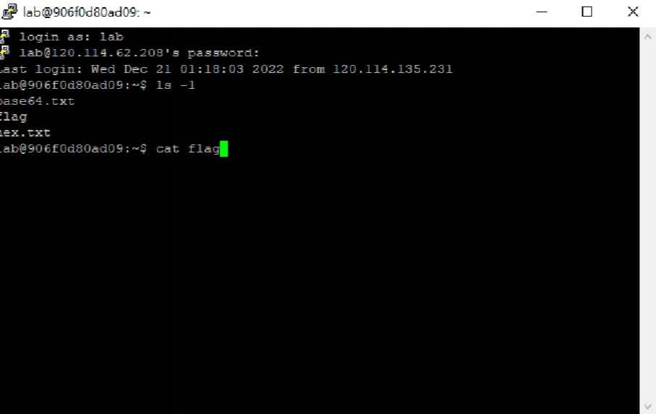

Slide 35
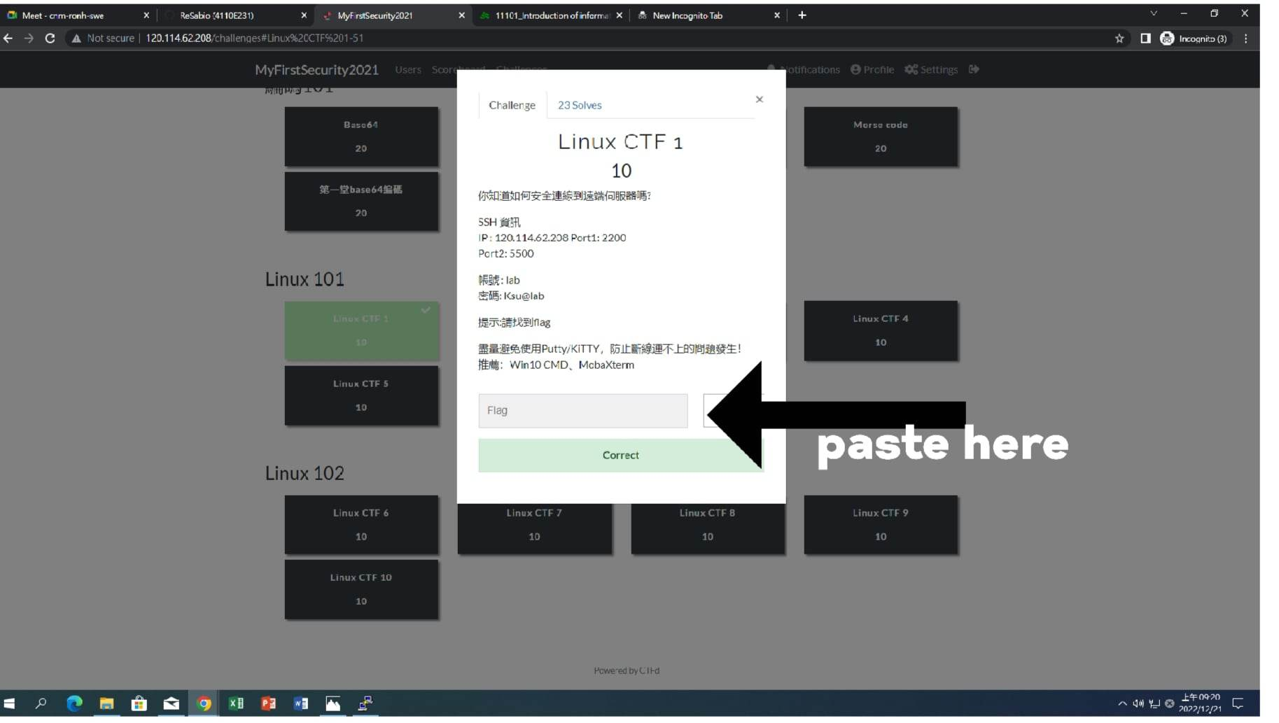

Slide 36
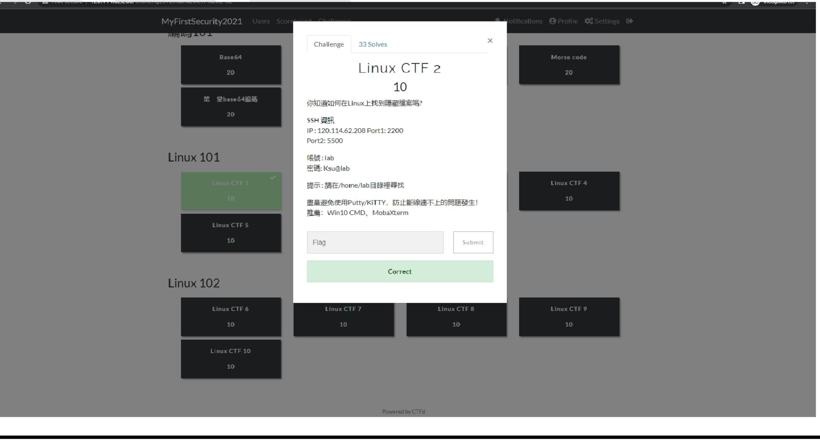
CTF2

Slide 37
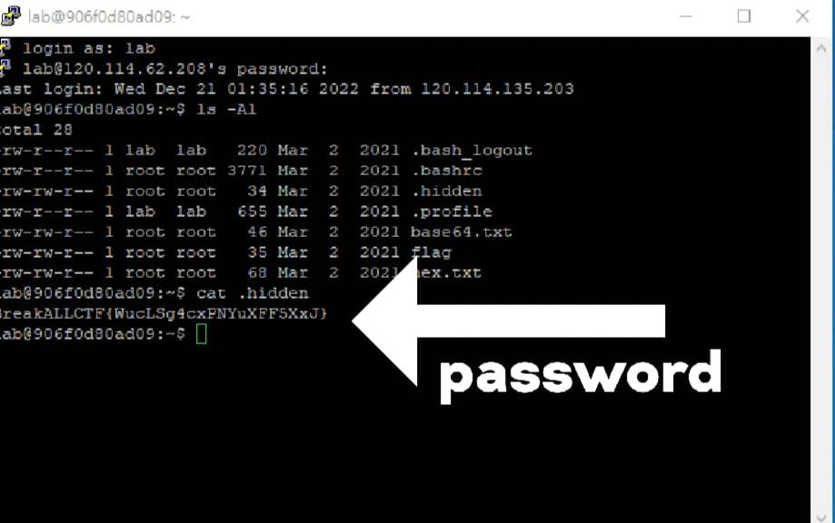
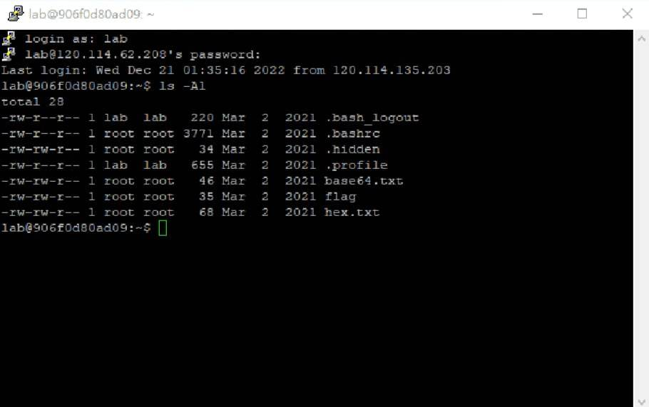

Slide 38
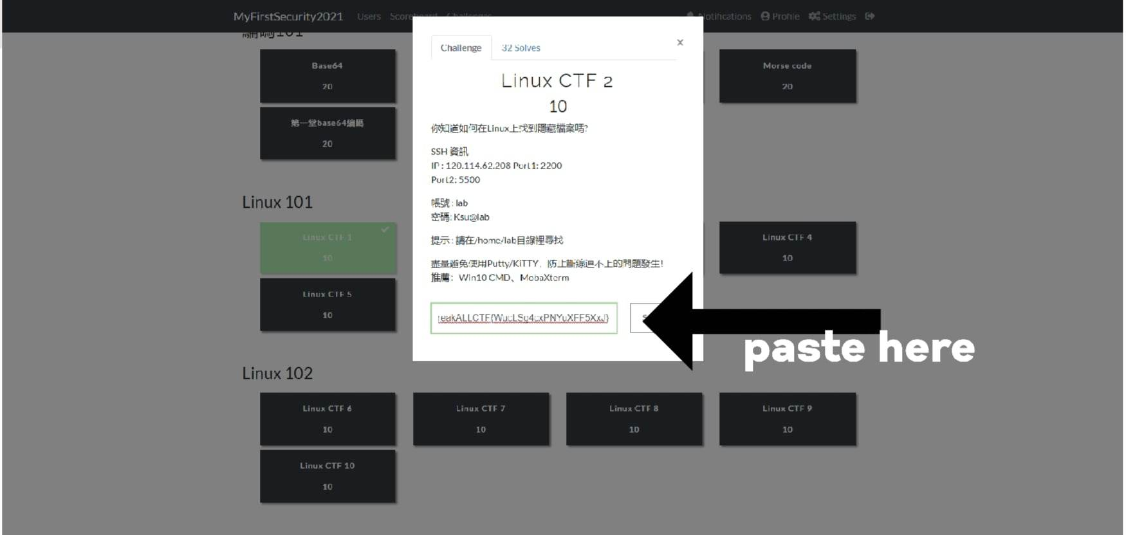

Slide 39
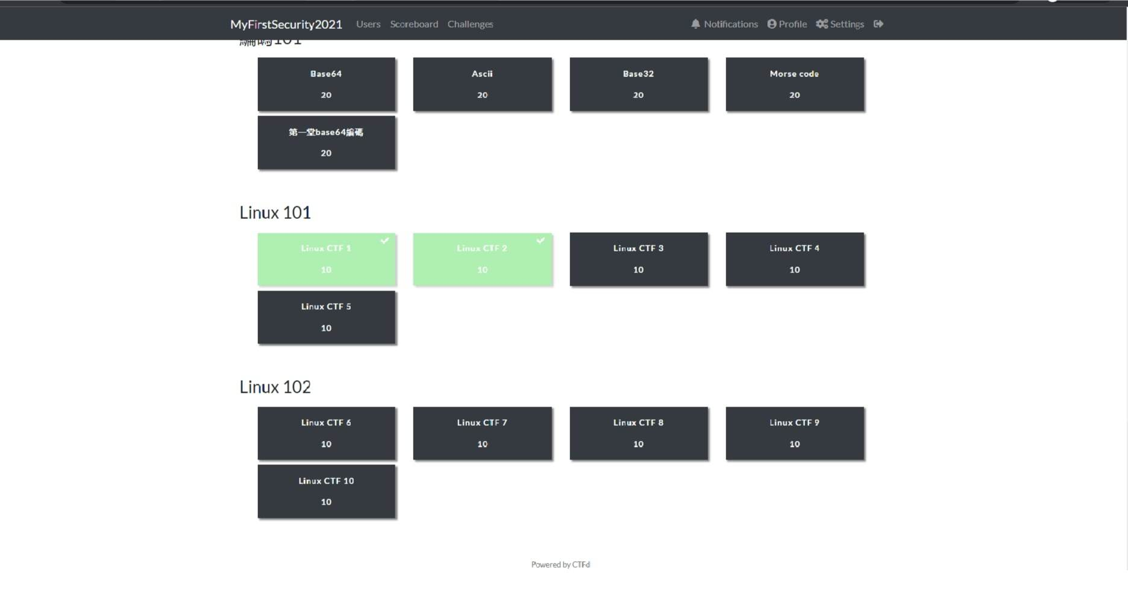

Slide 40
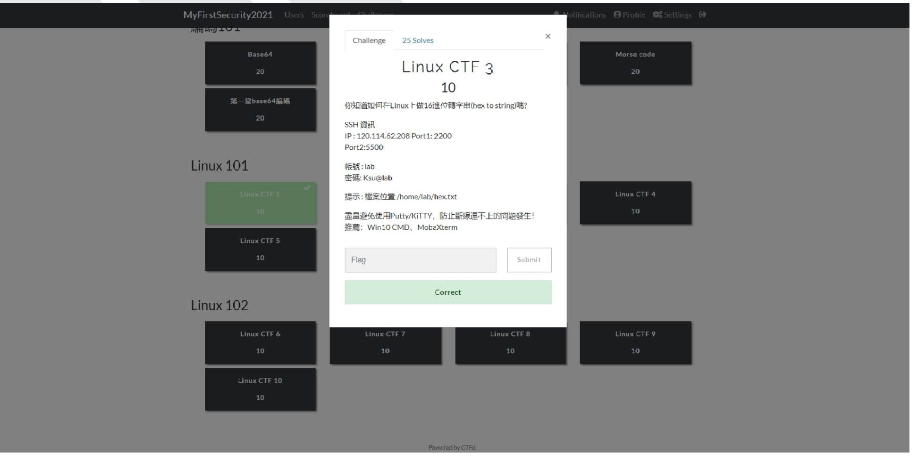
CTF 3

Slide 41
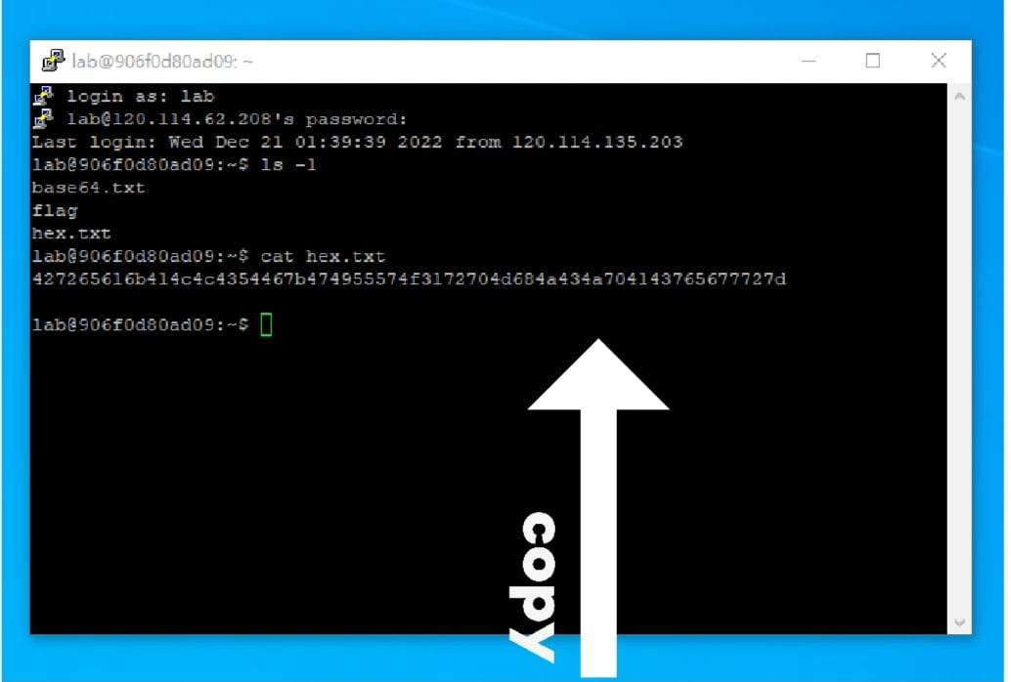
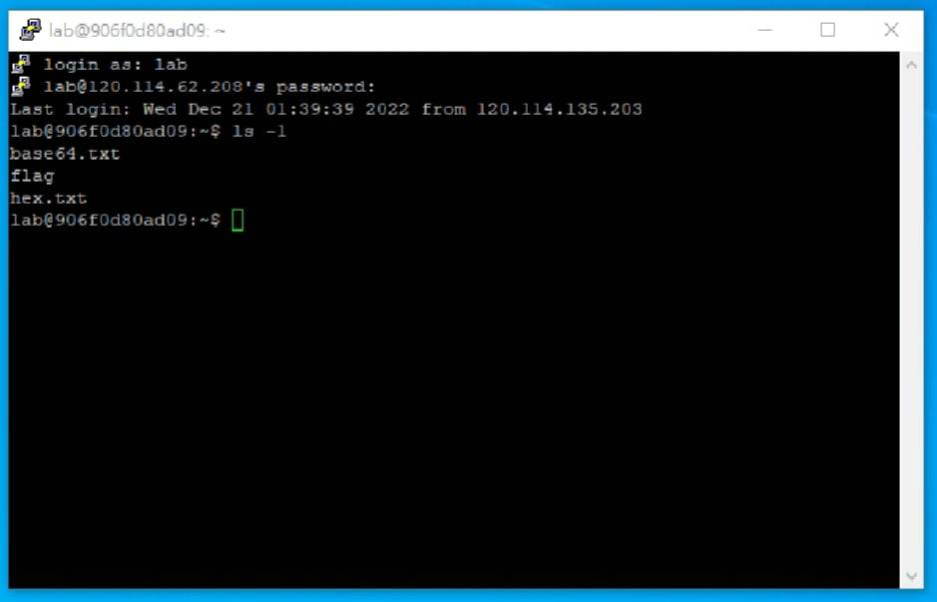

Slide 42
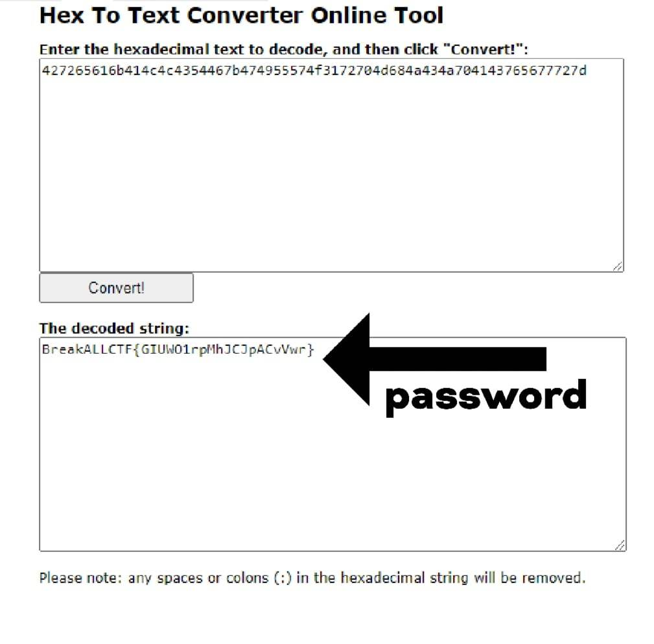

Slide 43
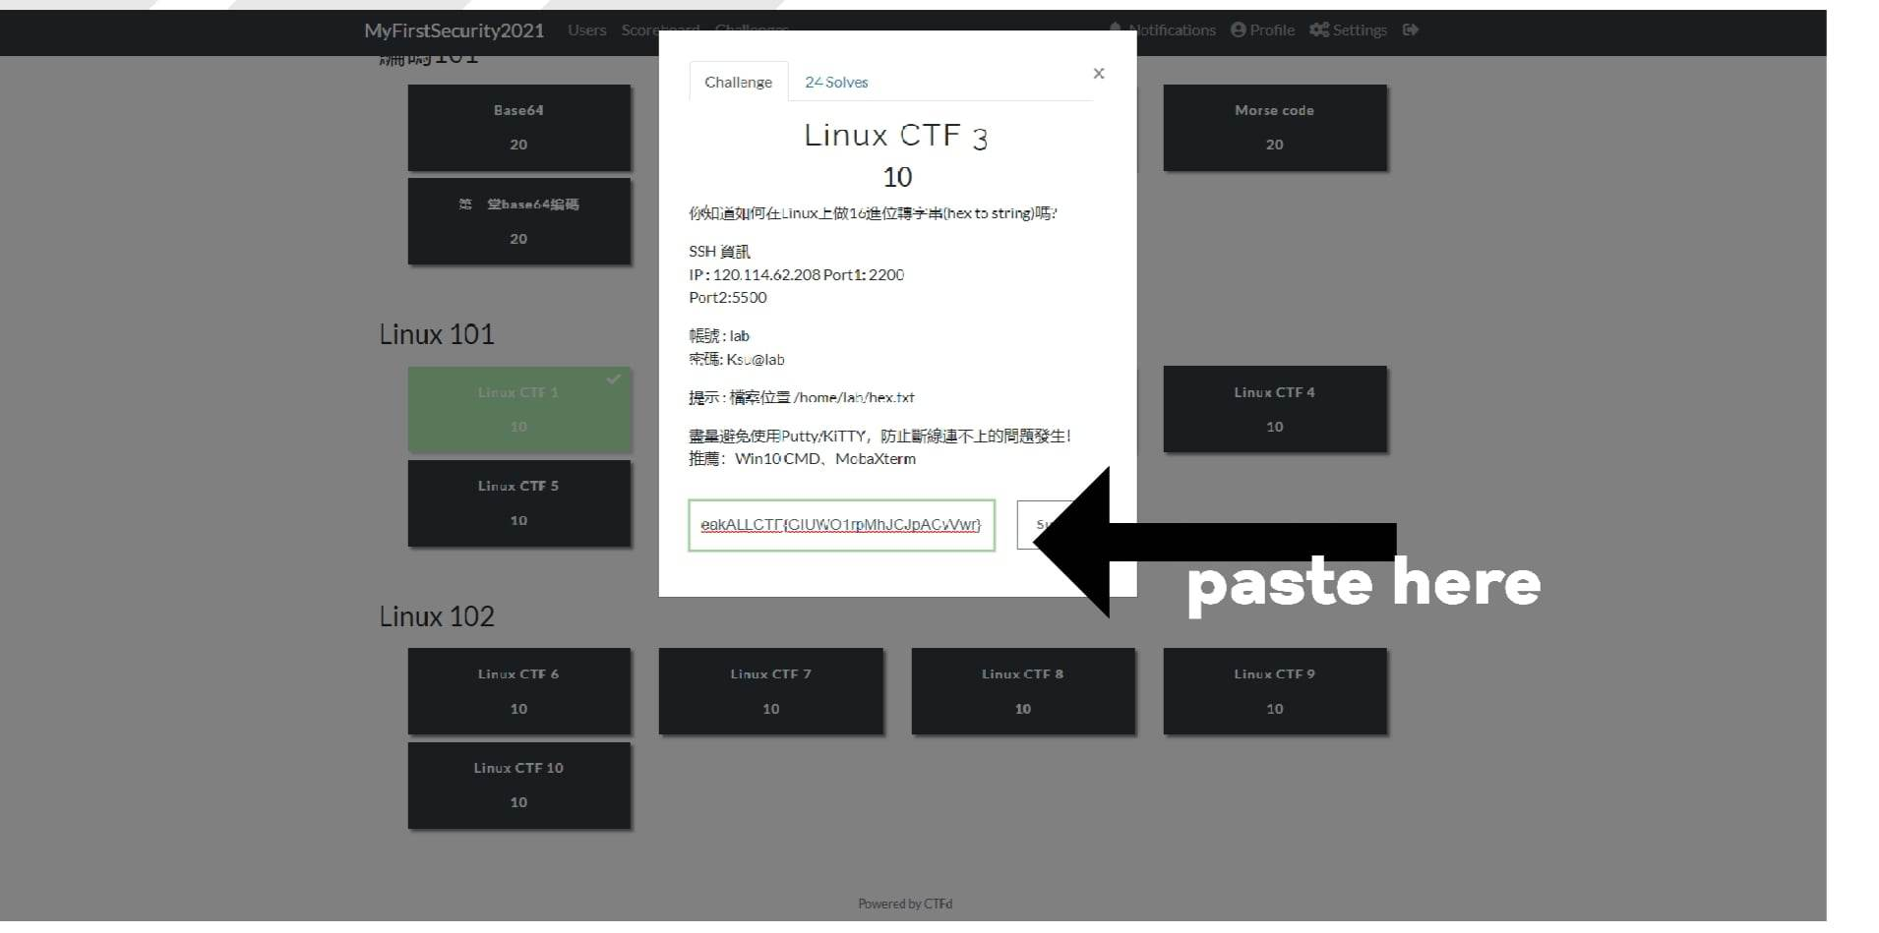

Slide 44
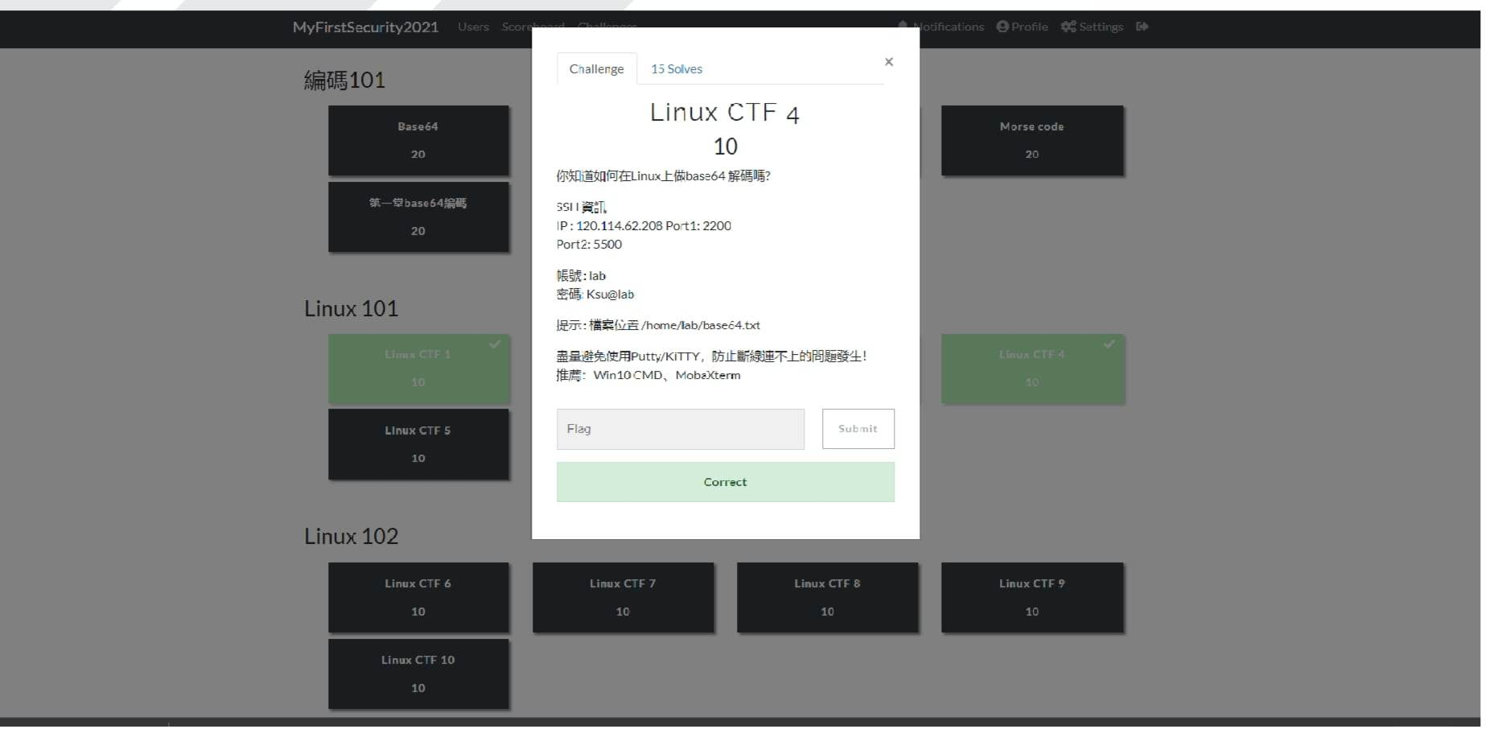
CTF 4

Slide 45
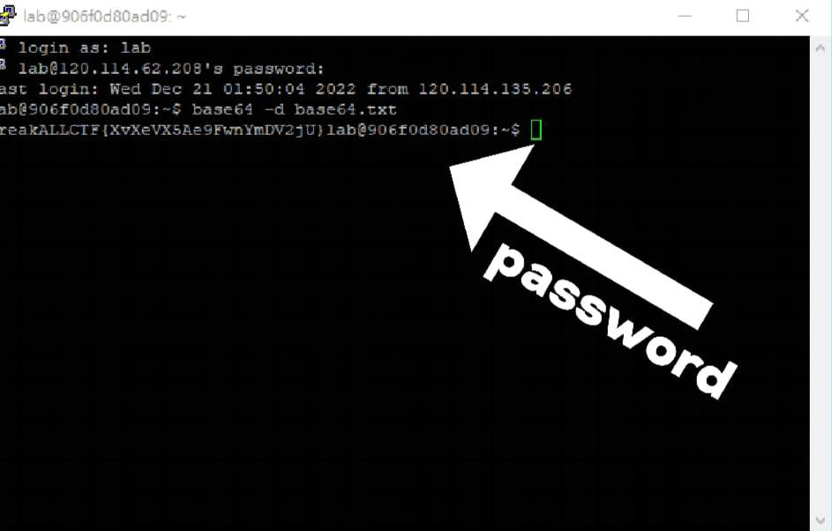
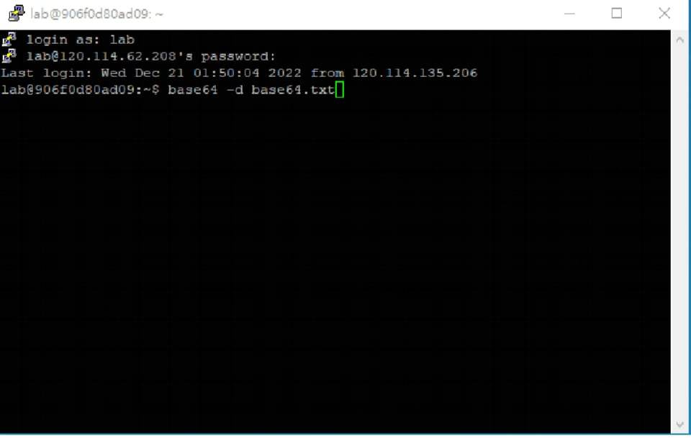

Slide 46
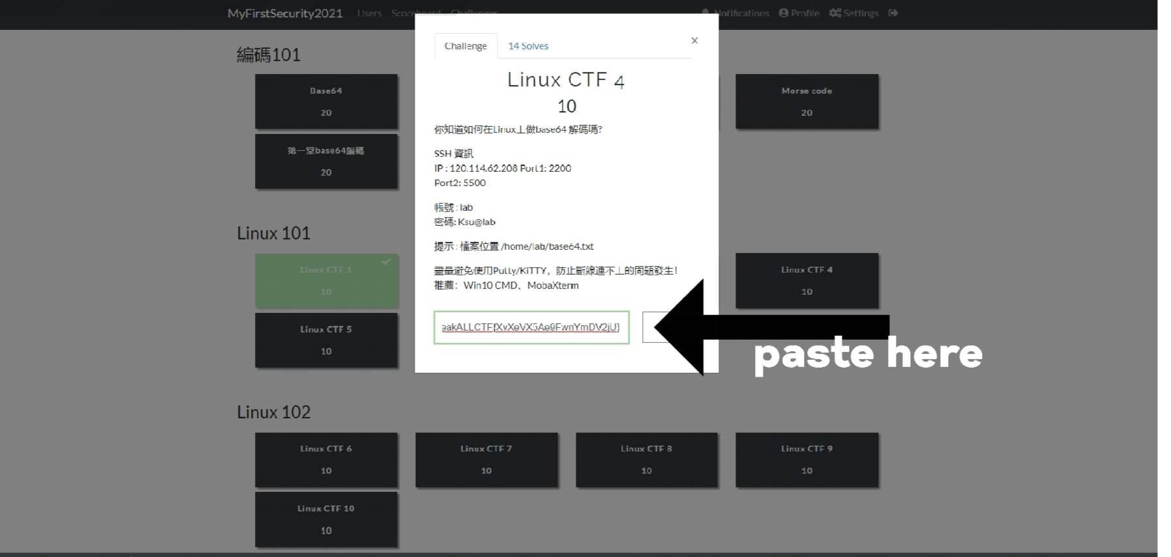

Slide 47
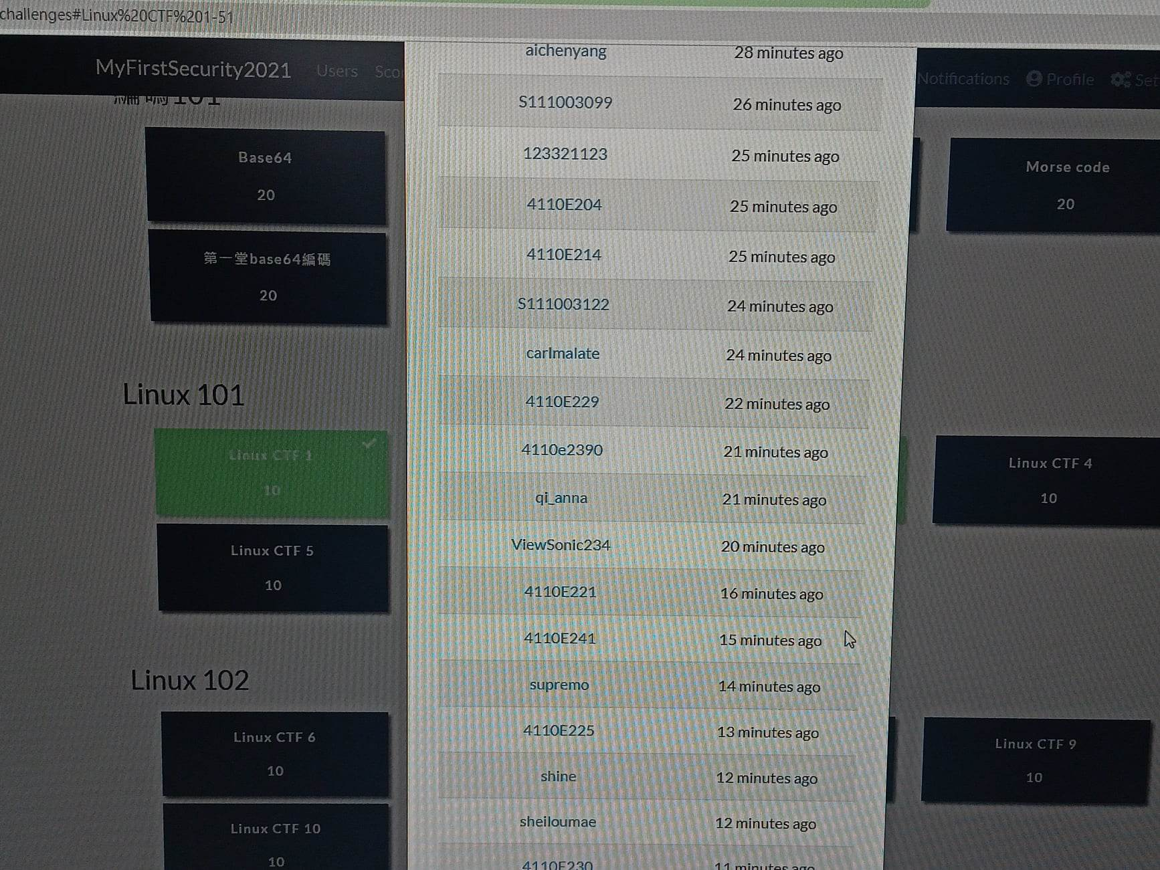
CTF 1

Slide 48
CTF 3

Slide 49
ctF 3

Slide 50
Ctf 4

Slide 51
tHank you!
STUDENT: 4110E241
TEACHER: MY DEAR GREAT TEACHER

